Slide 1














A Novel Gradient-Based ptuning Mrthod for Large Language Models
presented by
Siam Sadman Azad
ID: 2014002

Slide 2

Introduction
I am honored to stand before you today to share groundbreaking research that addresses a crucial challenge in the realm of artificial intelligence, particularly in the context of Large Language Models (LLMs).
This paper proposes a new pruning technique called GBLM-Pruner (Gradient-Based Language Model Pruner)
It is simple to implement, effective, and does not require retraining.

Slide 3
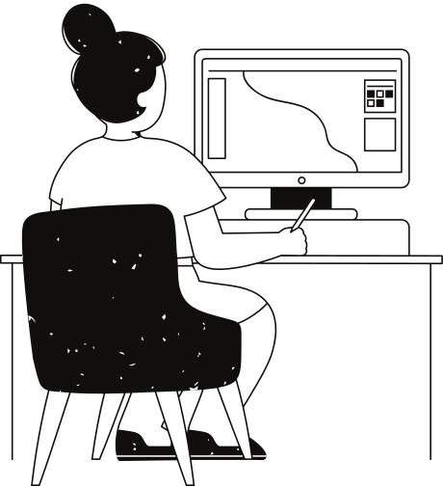
Prior Pruning Approach
Existing methods rely on weight magnitude or activation values.
They often overlook the valuable information contained in the gradients of the model.
Gradients provide insights into how each parameter contributes to the model's output, making them a valuable resource for identifying important parameters.

Slide 4

Proposed Method: GBLM-Pruner
GBLM-Pruner utilizes gradient information to identify redundant parameters.
GBLM-Pruner (Gradient-Based Language Model Pruner), a novel pruning method that leverages gradient information to identify and remove redundant parameters from LLMs.

Slide 5

Theoretical Underpinnings
GBLM-Pruner adapts the Optimal Brain Surgeon (OBS) algorithm to incorporate gradients.
Compute the Hessian Matrix
Invert the Hessian Matrix
Calculate the second-order derivatives of the loss function with respect to each weight in the neural network.
Form the Hessian matrix, which contains information about the curvature of the loss surface.
Invert the Hessian matrix to obtain the sensitivity matrix.
The sensitivity matrix represents how sensitive the loss function is to changes in each weight.
Compute Importance Scores
Prunning Decision
Use the sensitivity matrix to compute importance scores for each weight.
Higher importance scores indicate weights that, if removed, would have a more significant impact on the loss.
Set a threshold for the importance scores, and prune weights with scores below this threshold.
Weights with low importance scores are considered less critical to the network's performance and are pruned.

Slide 6

Empirical Evaluation
GBLM-Pruner outperforms existing methods on
LLaMA-1 and LLaMA-2.
We conducted extensive experiments on LLaMA-1 and LLaMA-2, two state-of-the-art LLMs. Our results demonstrate that GBLM-Pruner significantly outperforms existing pruning methods, achieving substantial reductions in model size while maintaining comparable performance.

Slide 7
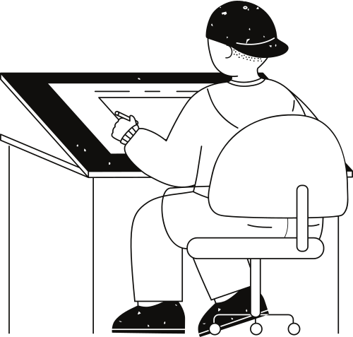

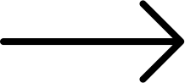



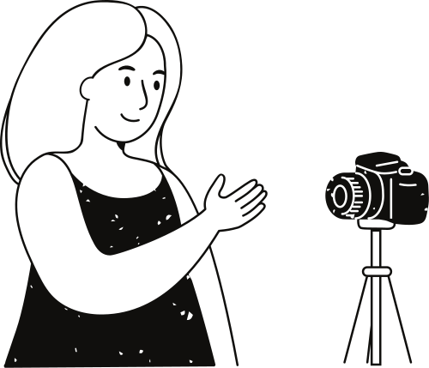
Training free, less resources intensive,
utilization of tylor expansion
GBLM-Pruner
outperformance in benchmark
gradiant based
advantages
Simple and interpretable
structural patterns post-pruning

Slide 8
Thank you very much!
for you Time

